Slide 1

Ishita Mohindra
Ankit Nagda
Pranit Mhatre
CSCI-588 - SPECIFICATION AND DESIGN OF USER INTERFACE SOFTWARE

Slide 2
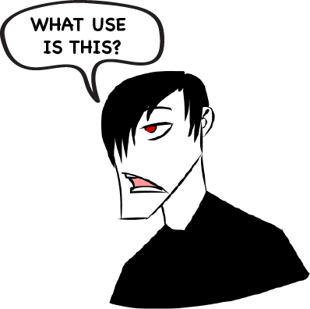

What is our Point?
Smooth
Wait free

Slide 3



What is our Point?
Increases Sales
Decreases Frustration

Slide 4
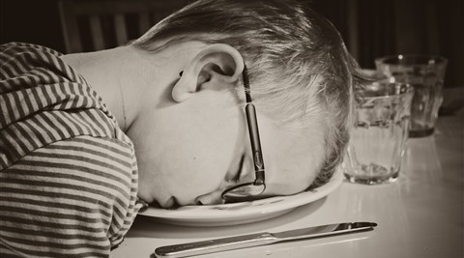
Sad… ☹

Slide 5

Why this Idea??

Slide 6
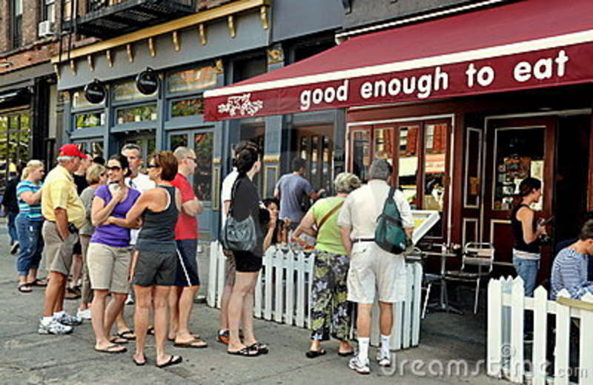
Why this Idea??
Familiar sight?

Slide 7
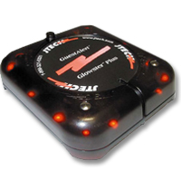
Why this Idea??
Restaurant Pager
Does this solve the problem?

Slide 8

What Makes us Different?
Reduced wait time in the restaurant
M-commerce
Independence
Use of smart phone

Slide 9

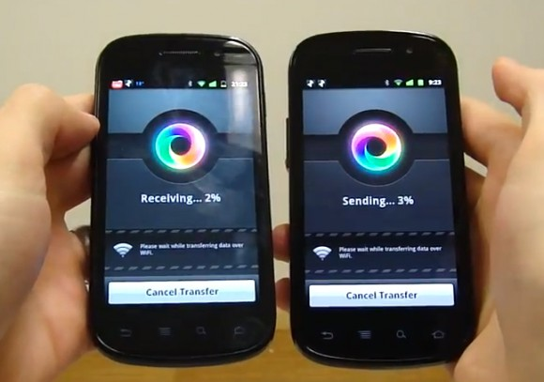
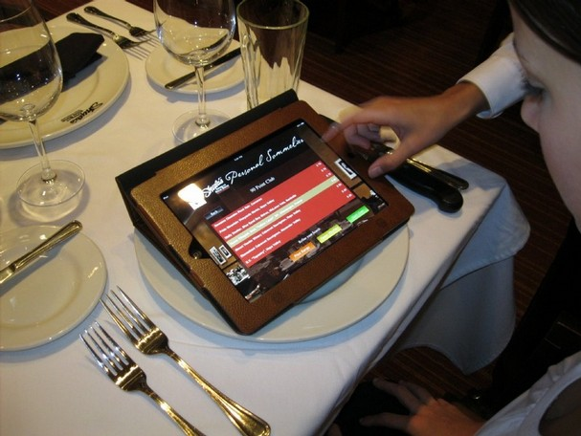
What Technology is this?
Near Field Communication
Use of Android smart phones and tablets

Slide 10

What is really going on?
Step 1: User Books a table from his smart phone
Step 2: He gets a text confirmation
Step 3: He checks in using the NFC in the restaurant
Step 4: He orders the food and it gets processed
Step 5: He pays the bill Using his smartphone
Step 6: He leaves the place… happily ever after!

Slide 11
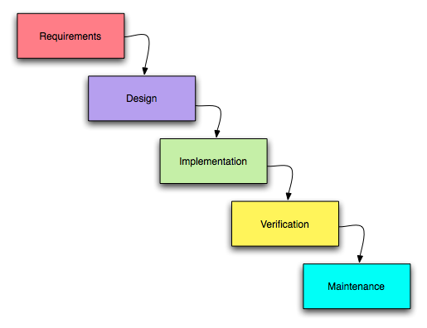
What is our Dev Model?
Waterfall Model

Slide 12
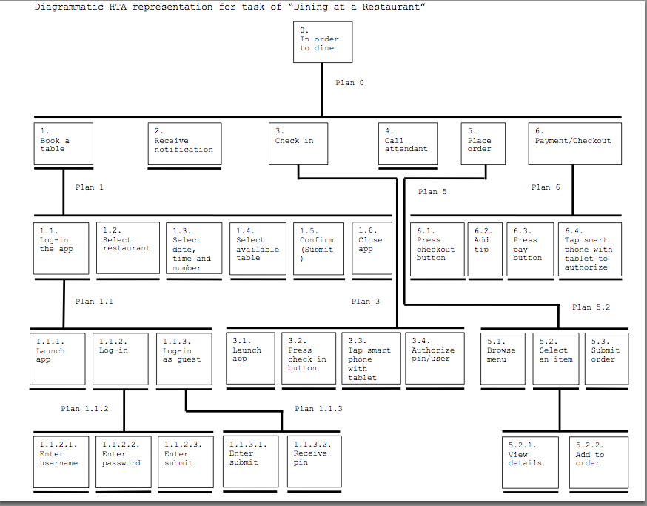
What is our HTA?

Slide 13
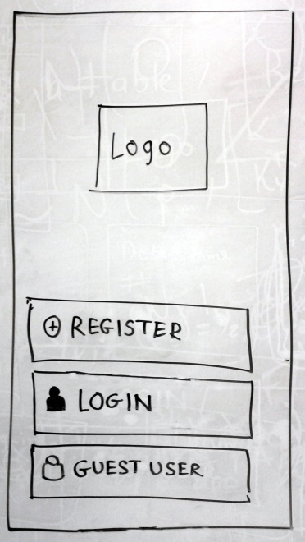
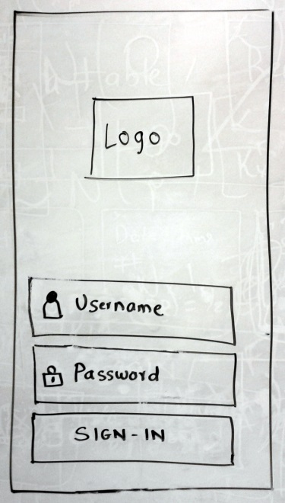
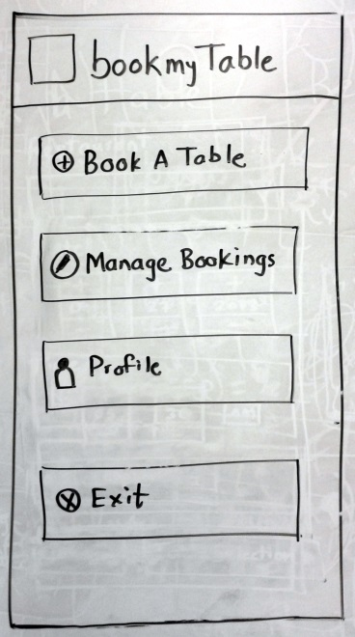
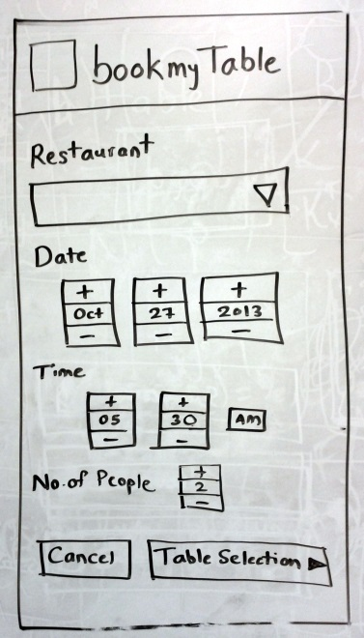
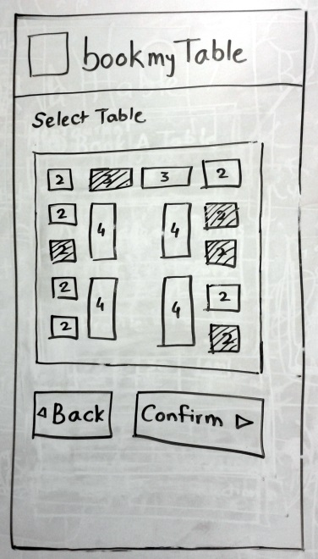
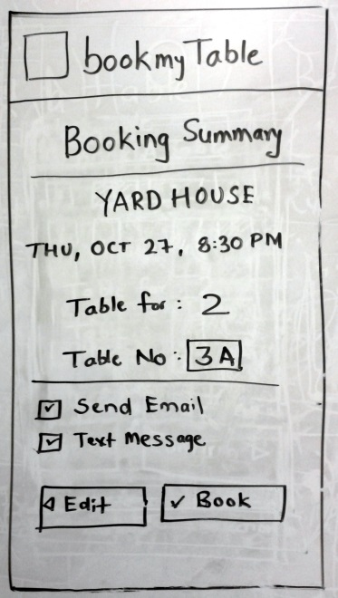
Low Fidelity Prototype

Slide 14
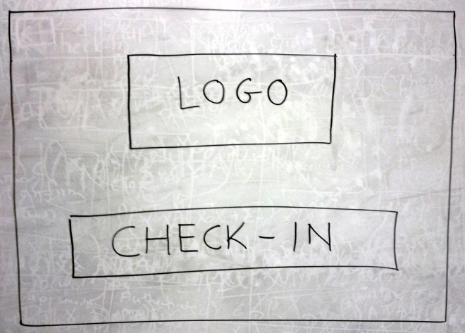
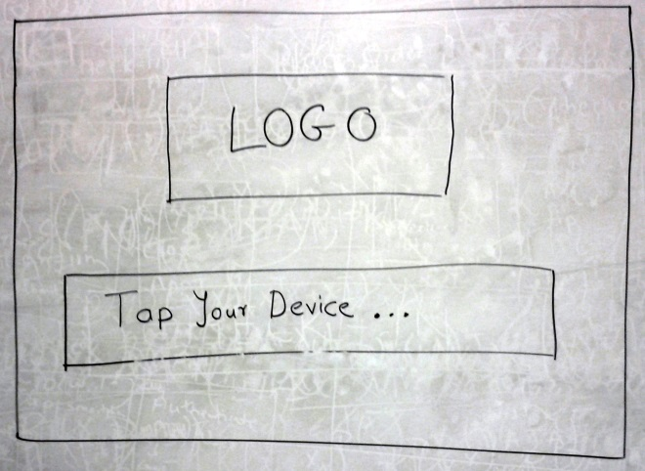
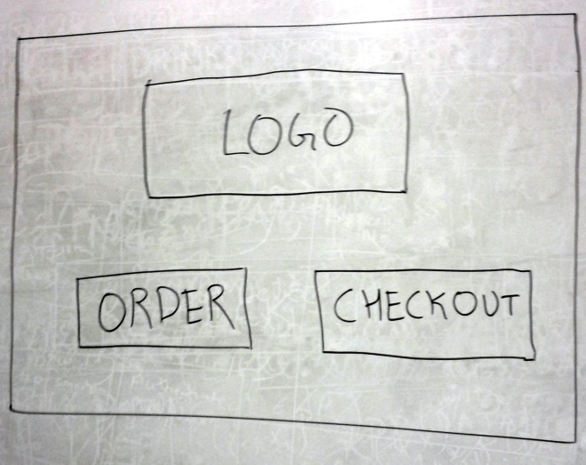
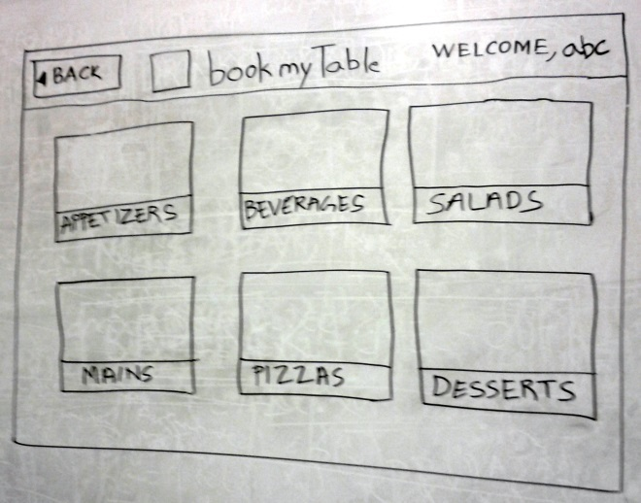
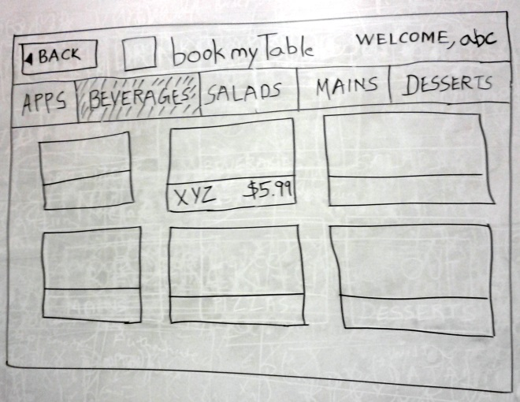
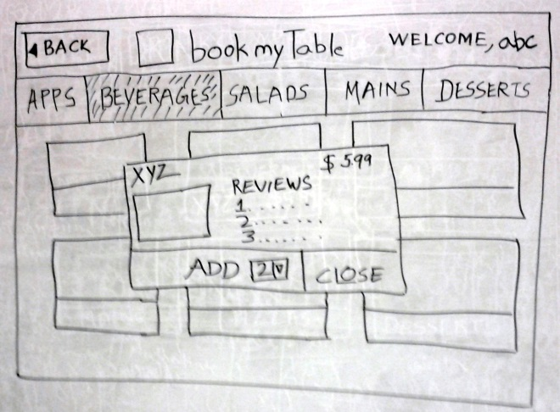
Low Fidelity Prototype

Slide 15
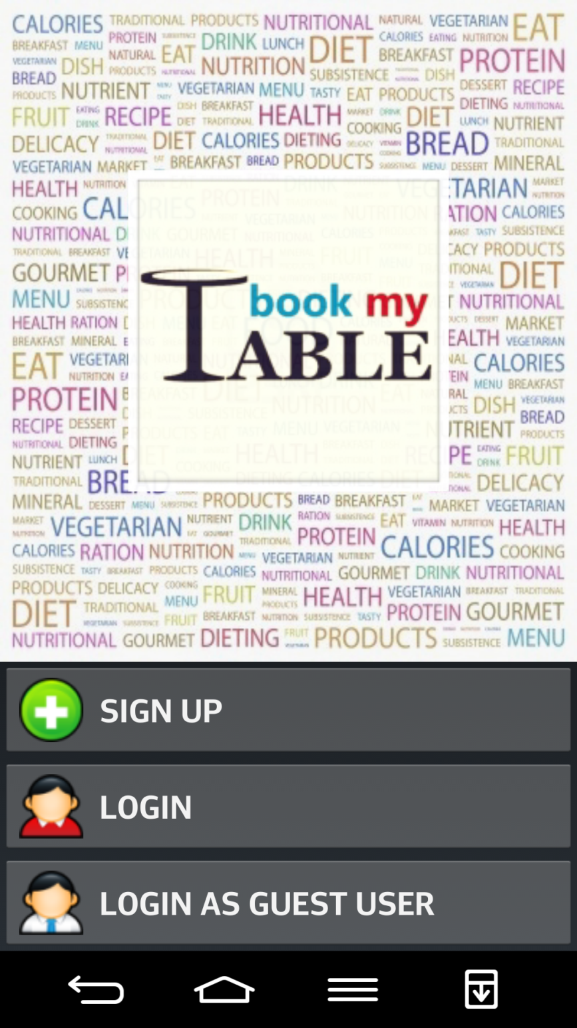
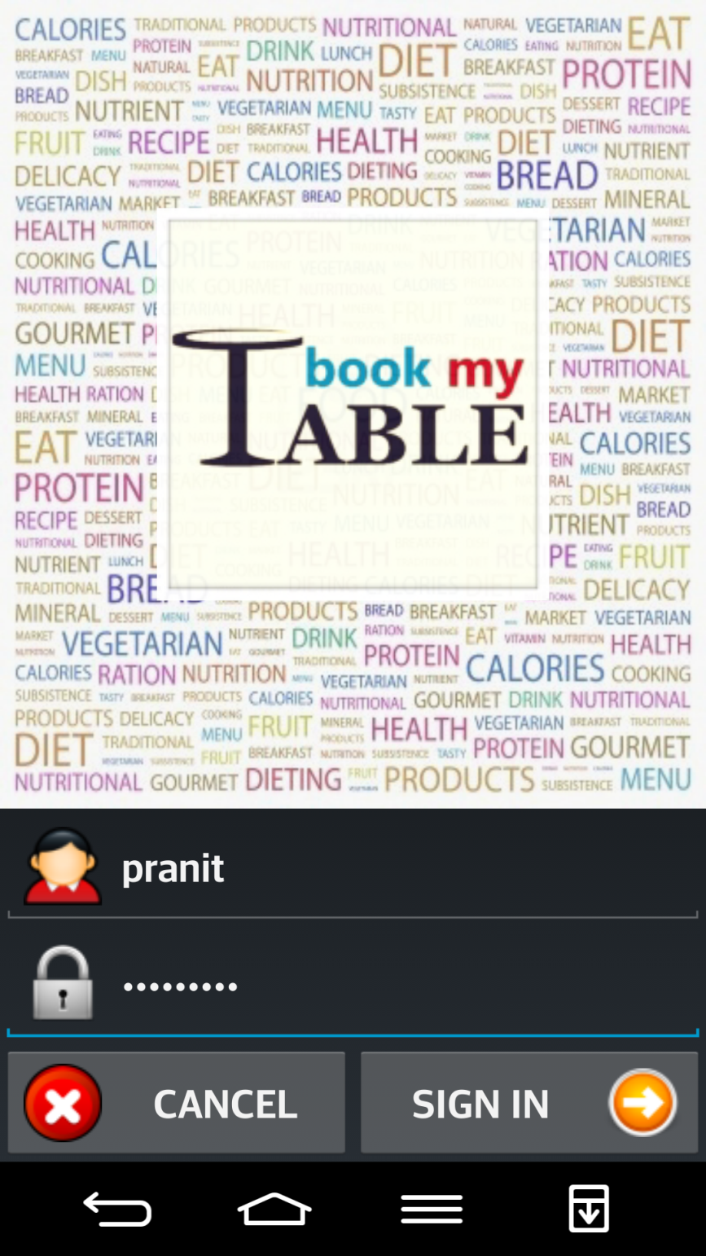

Slide 16
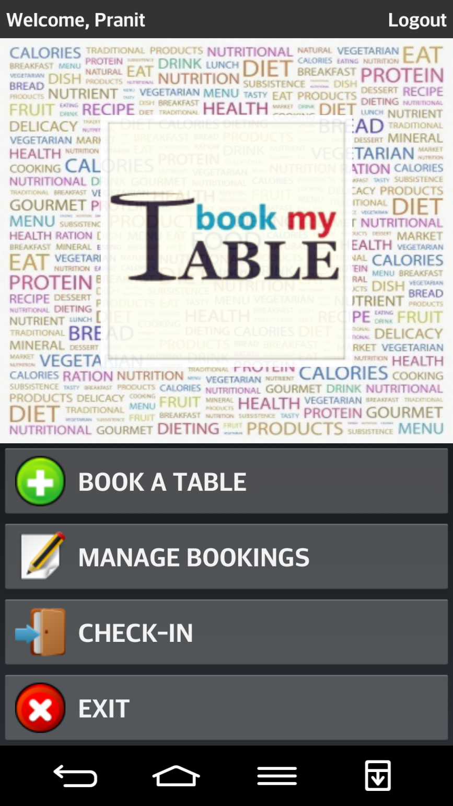
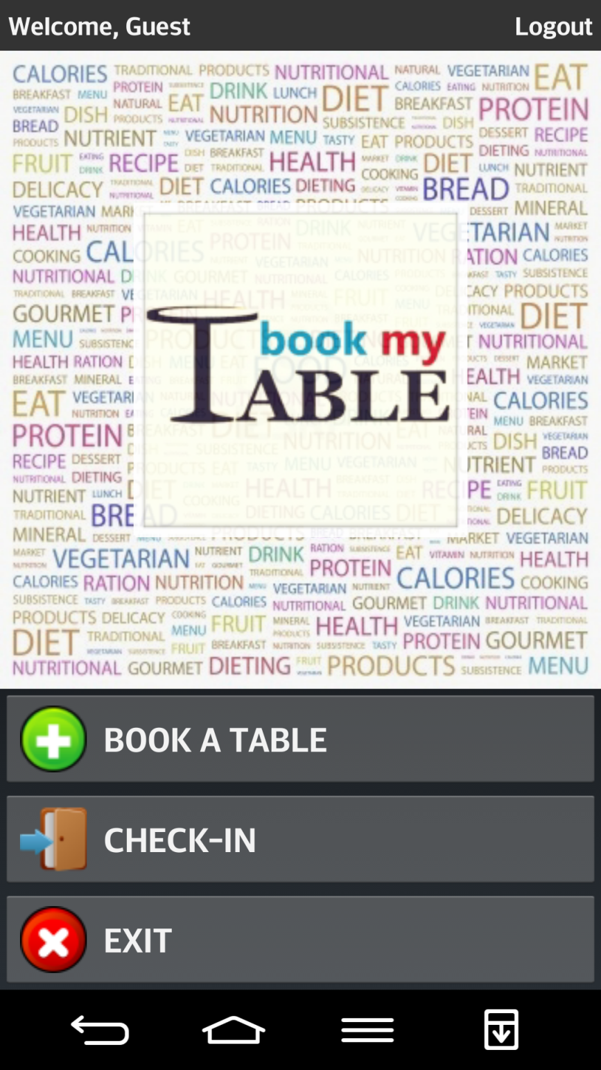

Slide 17
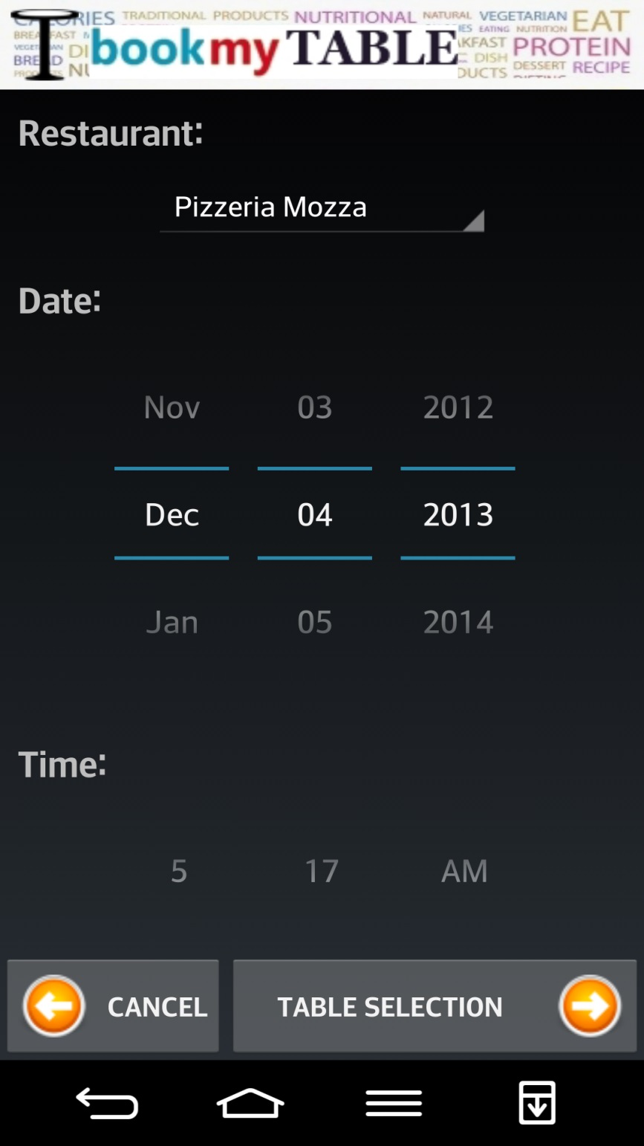
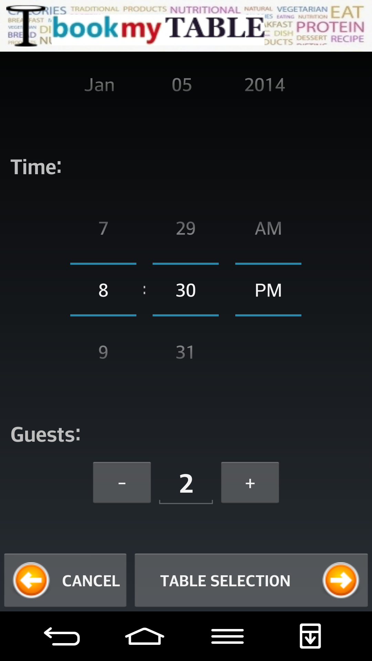

Slide 18
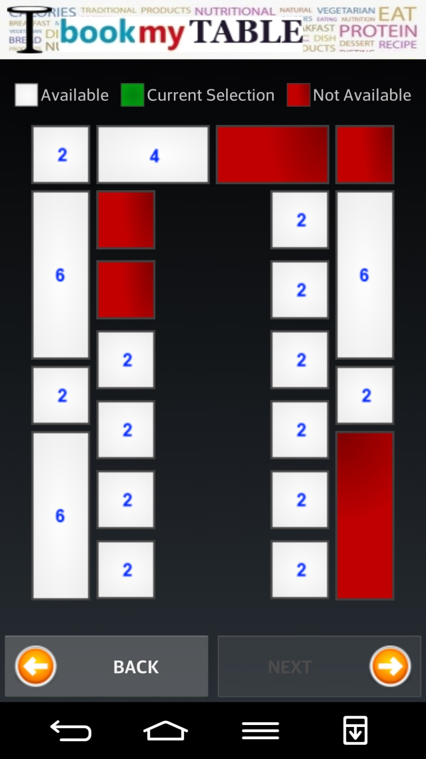
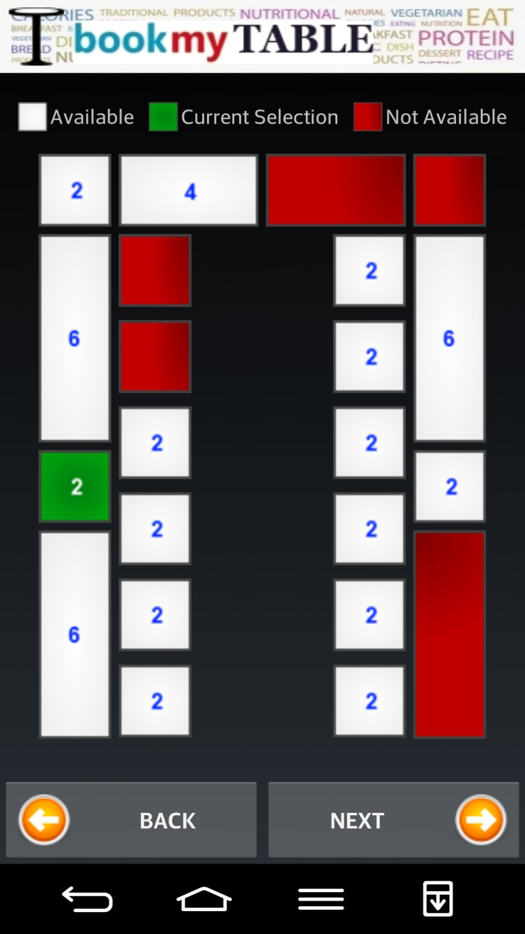

Slide 19
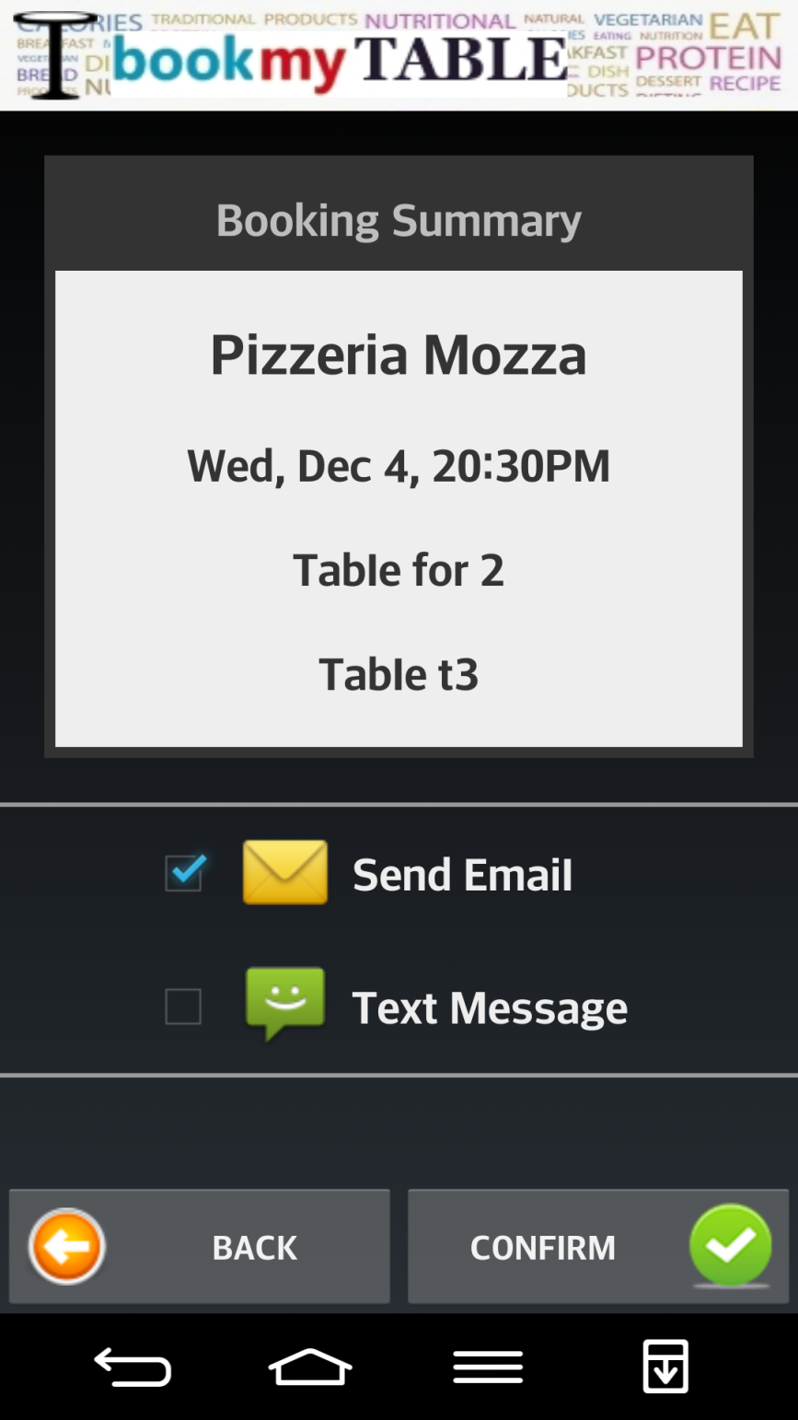
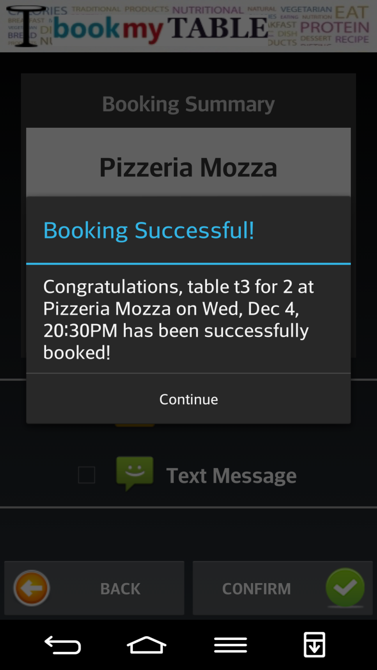

Slide 20
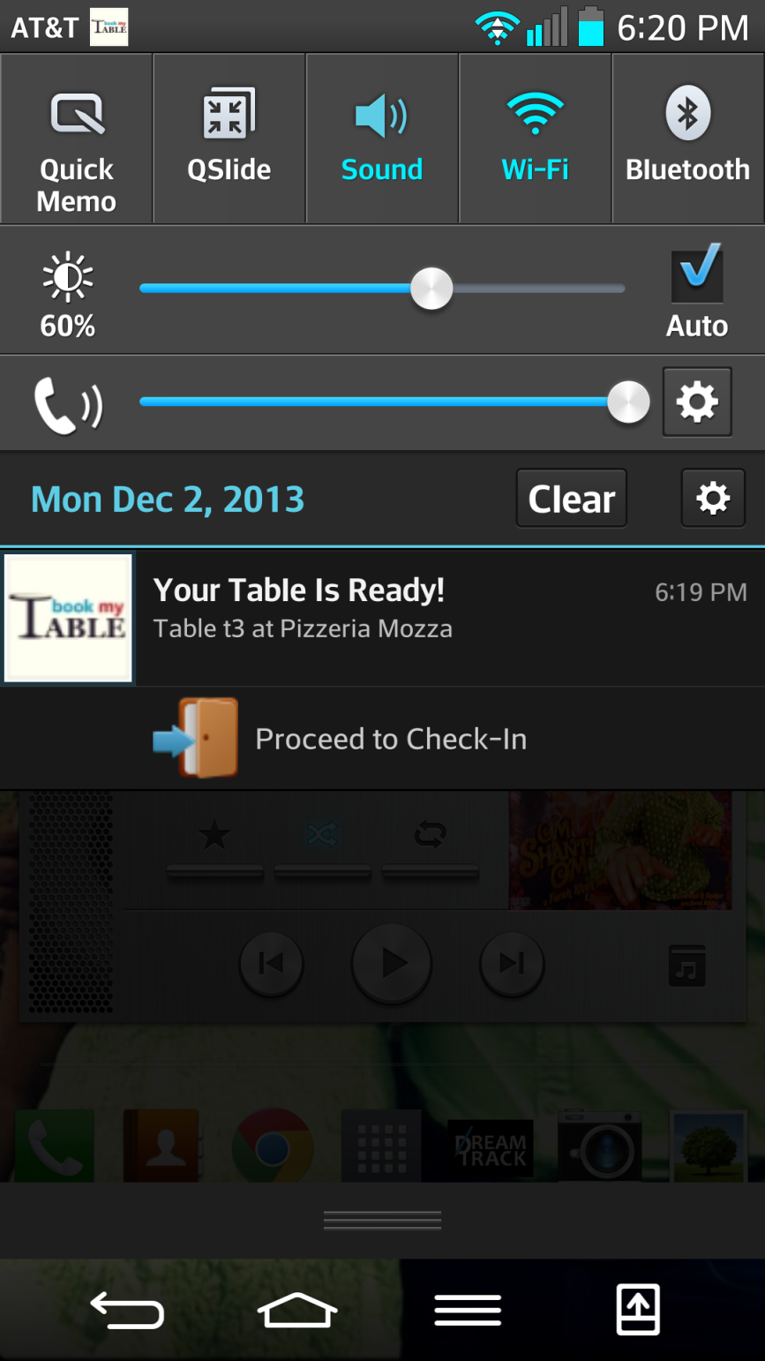

Slide 21
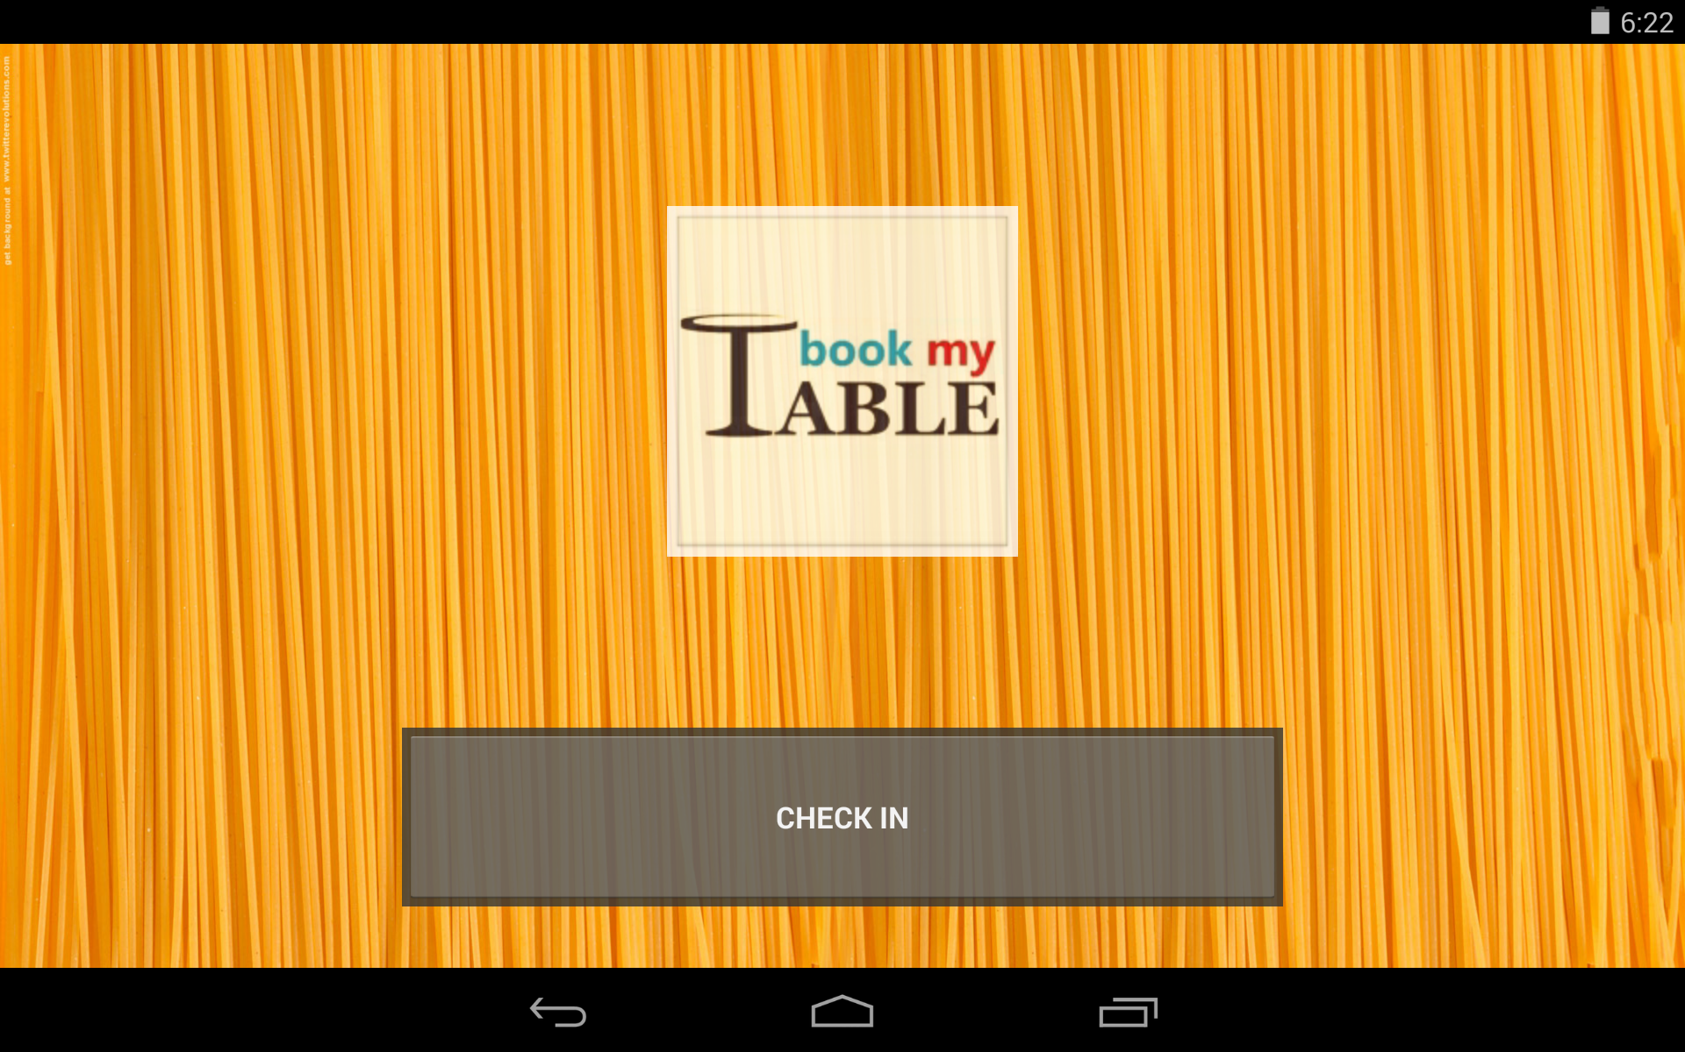

Slide 22
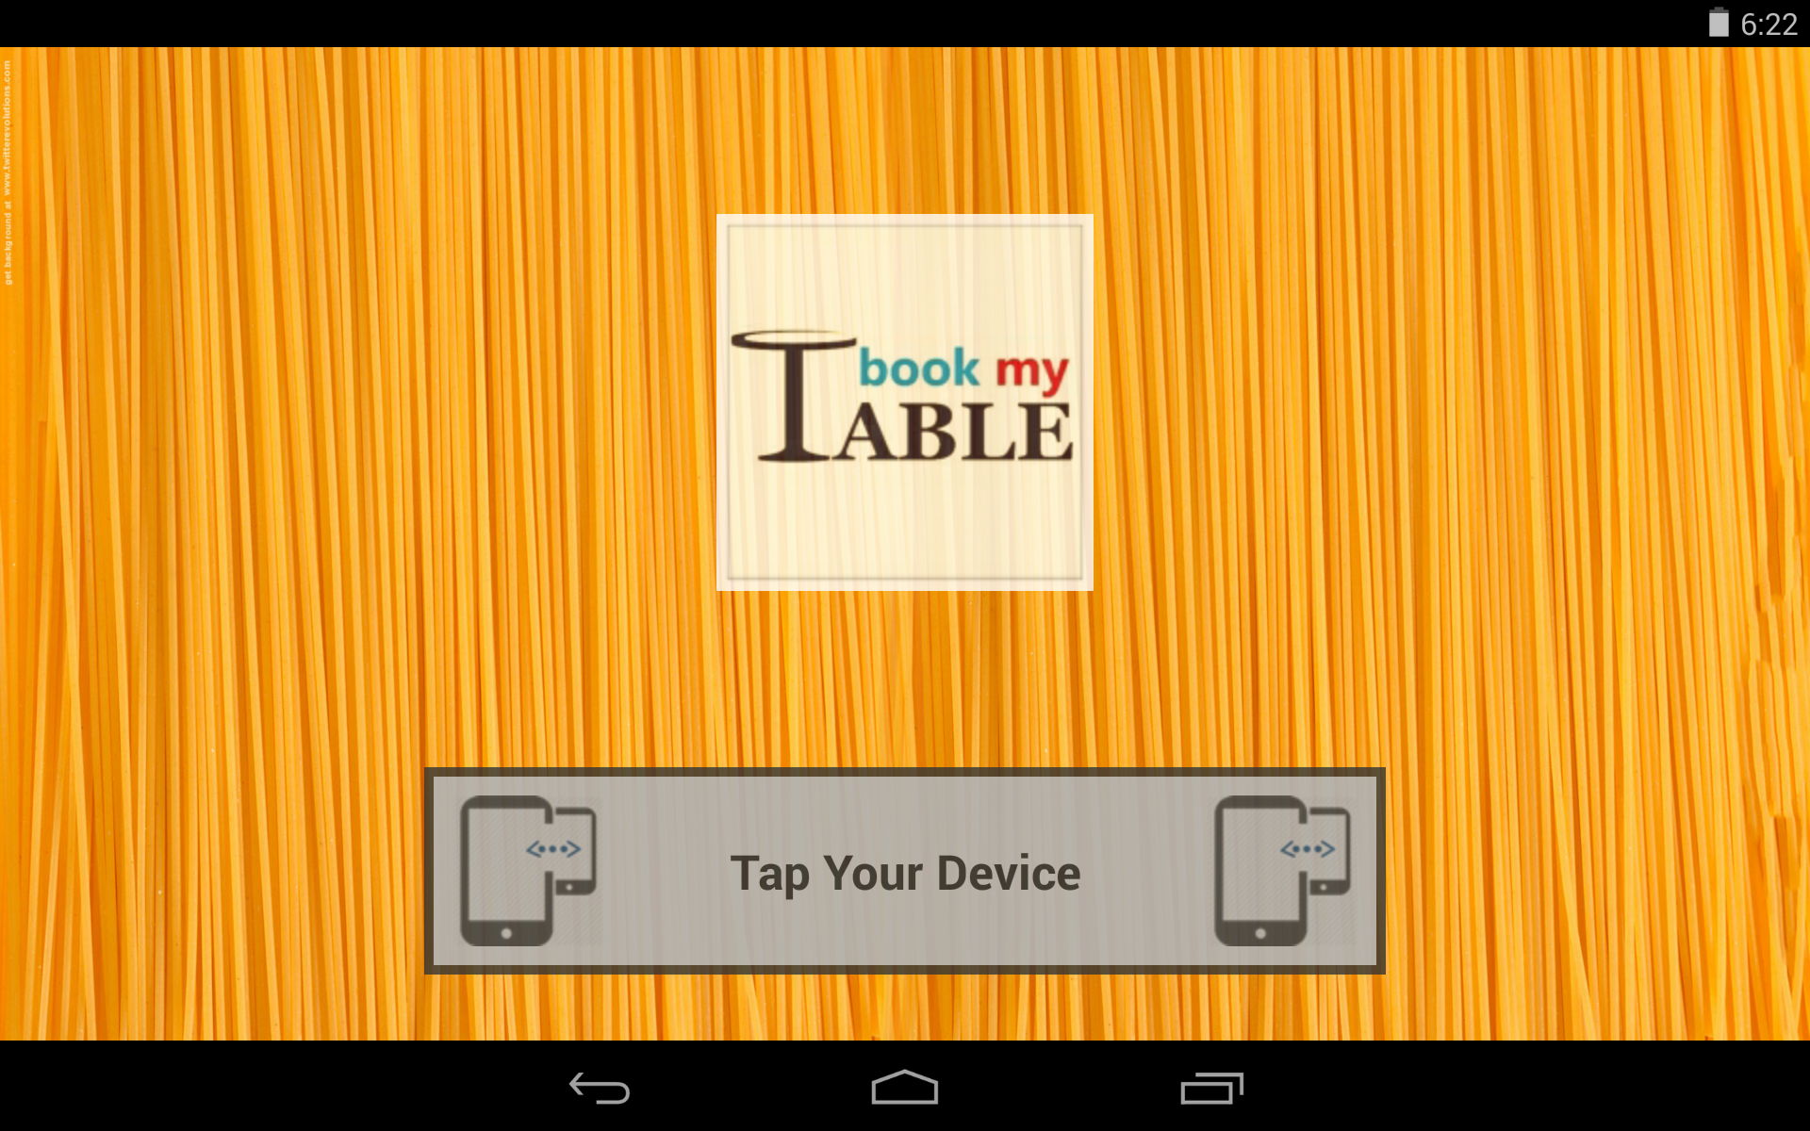

Slide 23
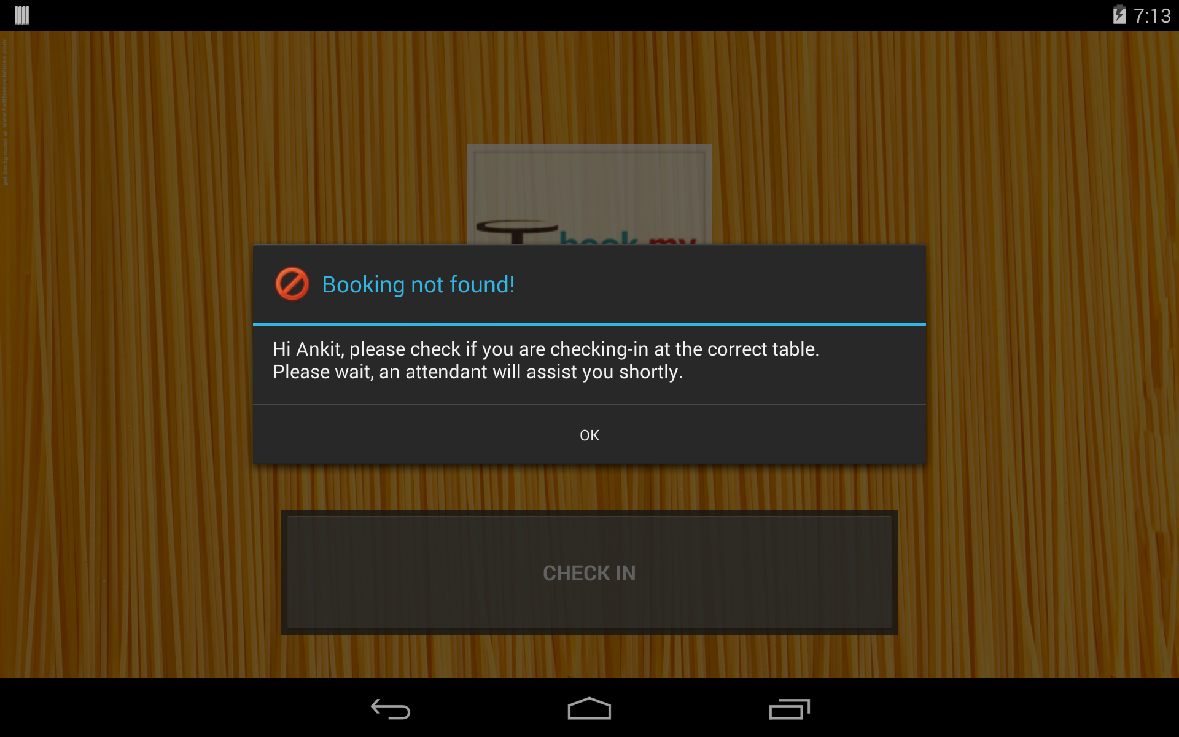

Slide 24
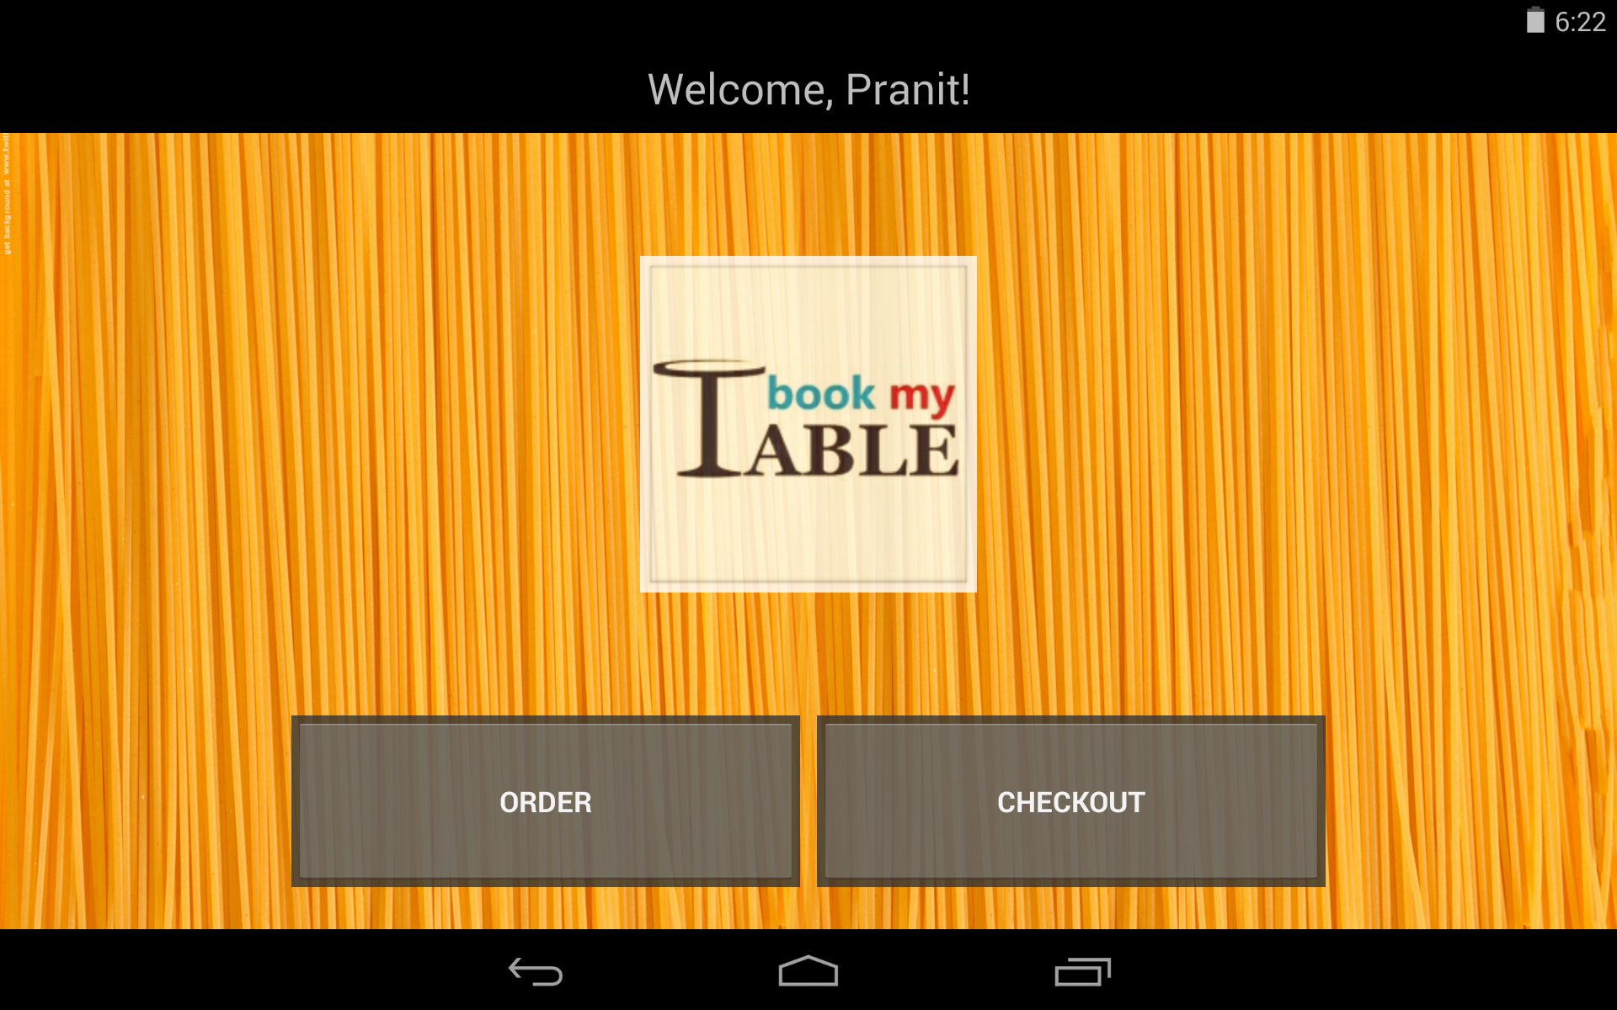

Slide 25
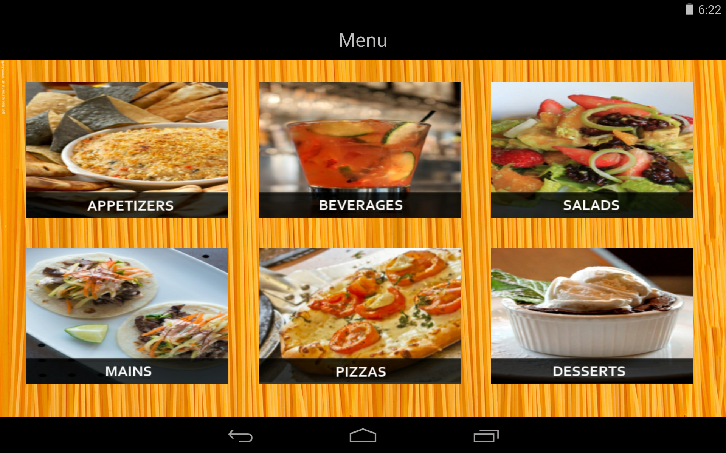

Slide 26
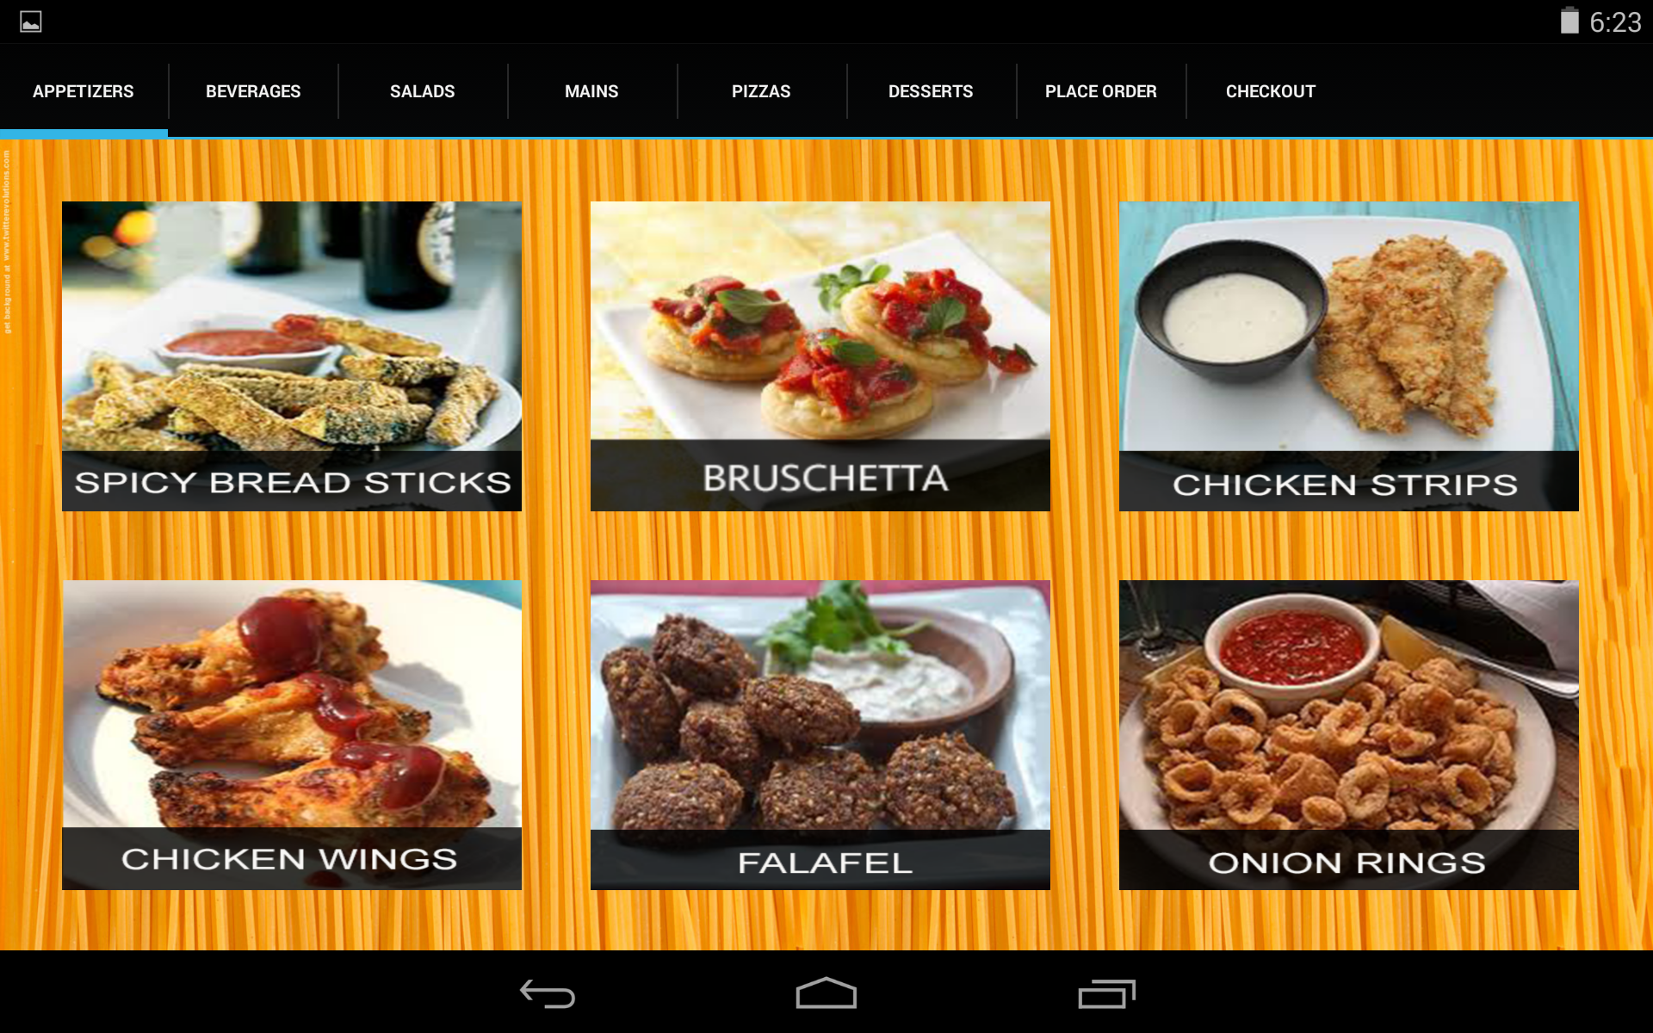

Slide 27
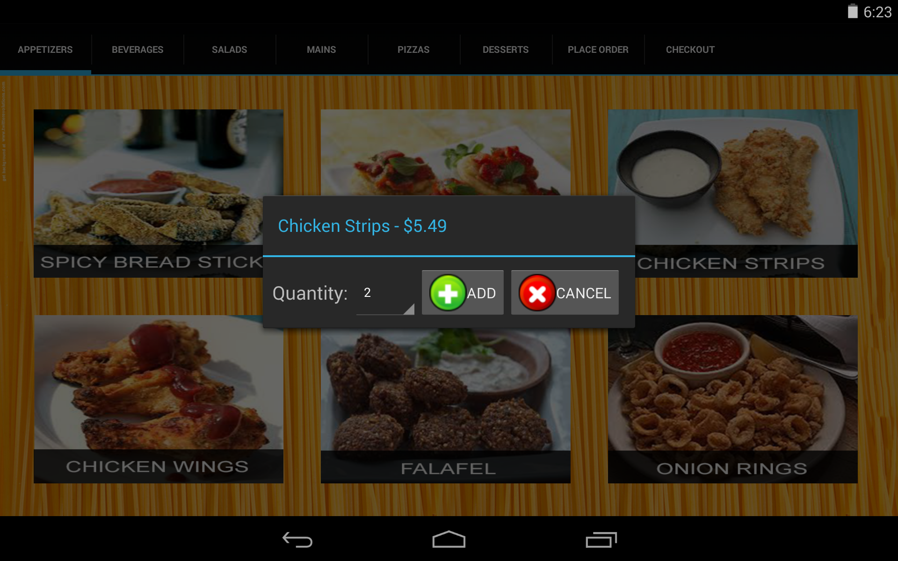

Slide 28
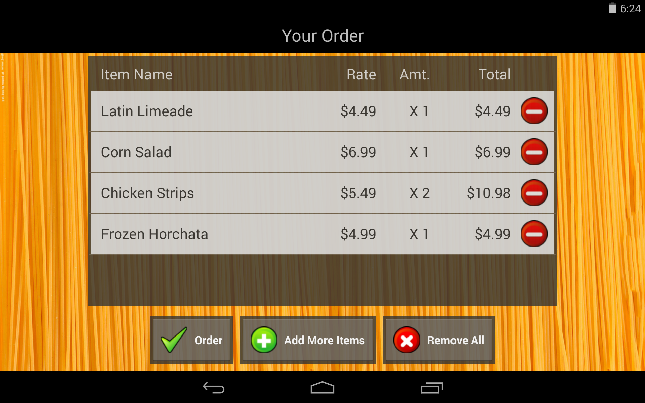

Slide 29
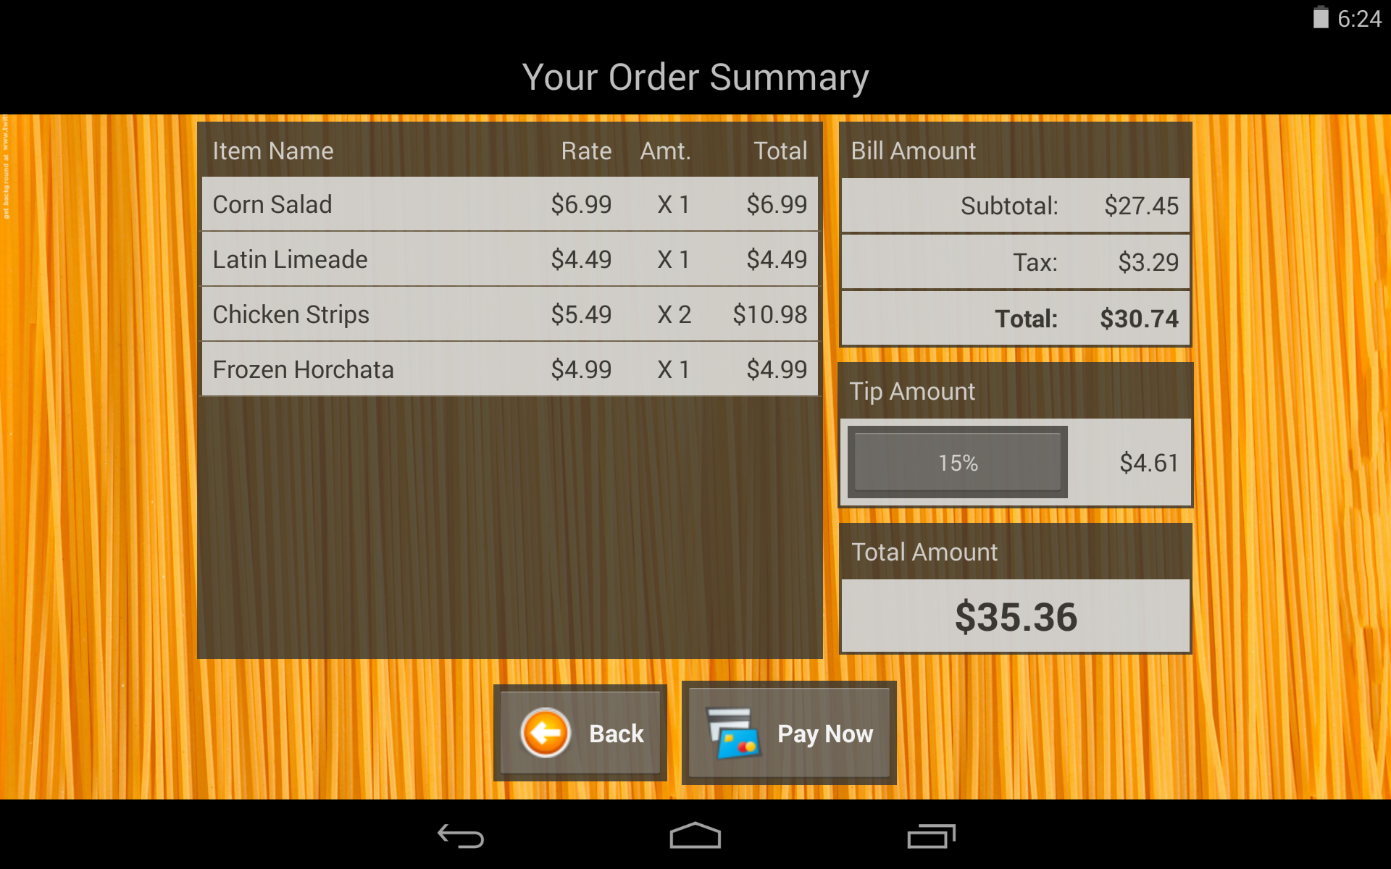

Slide 30
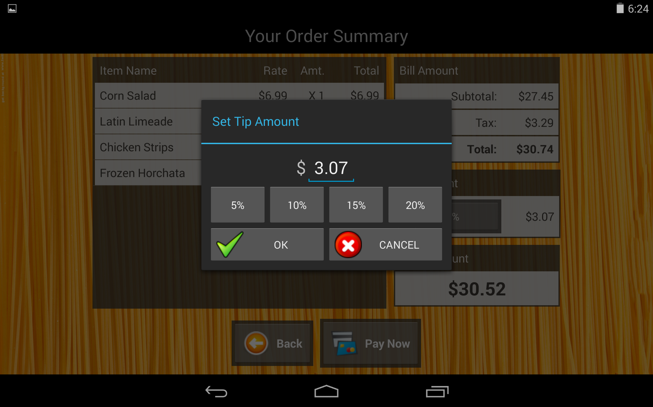

Slide 32
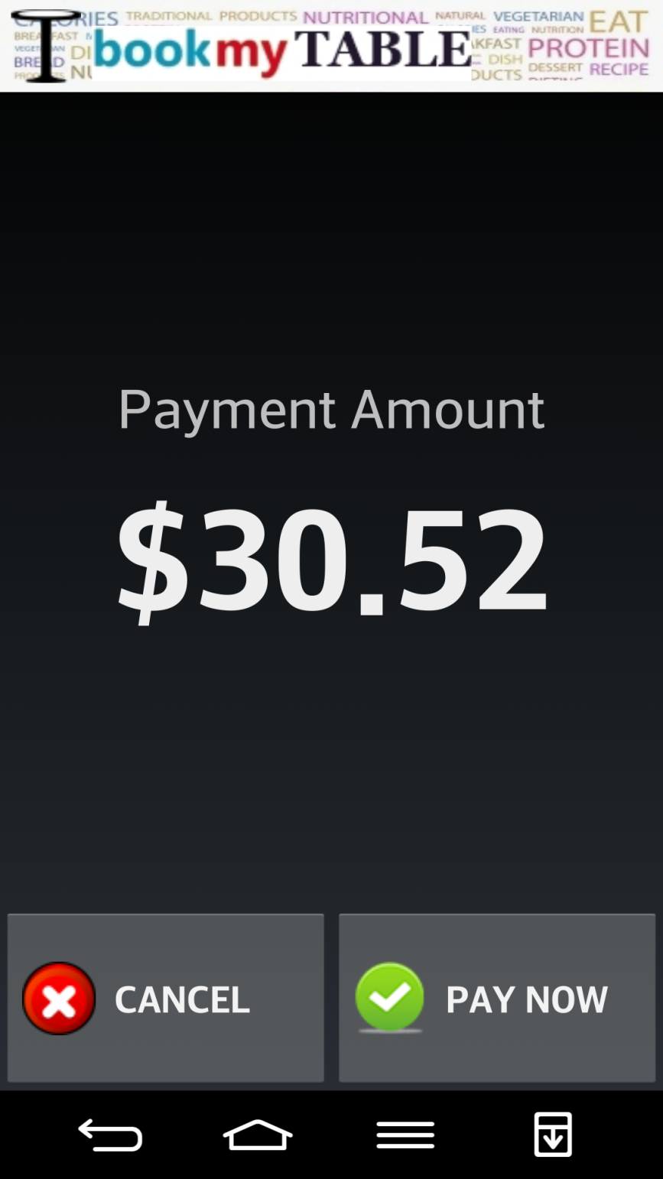
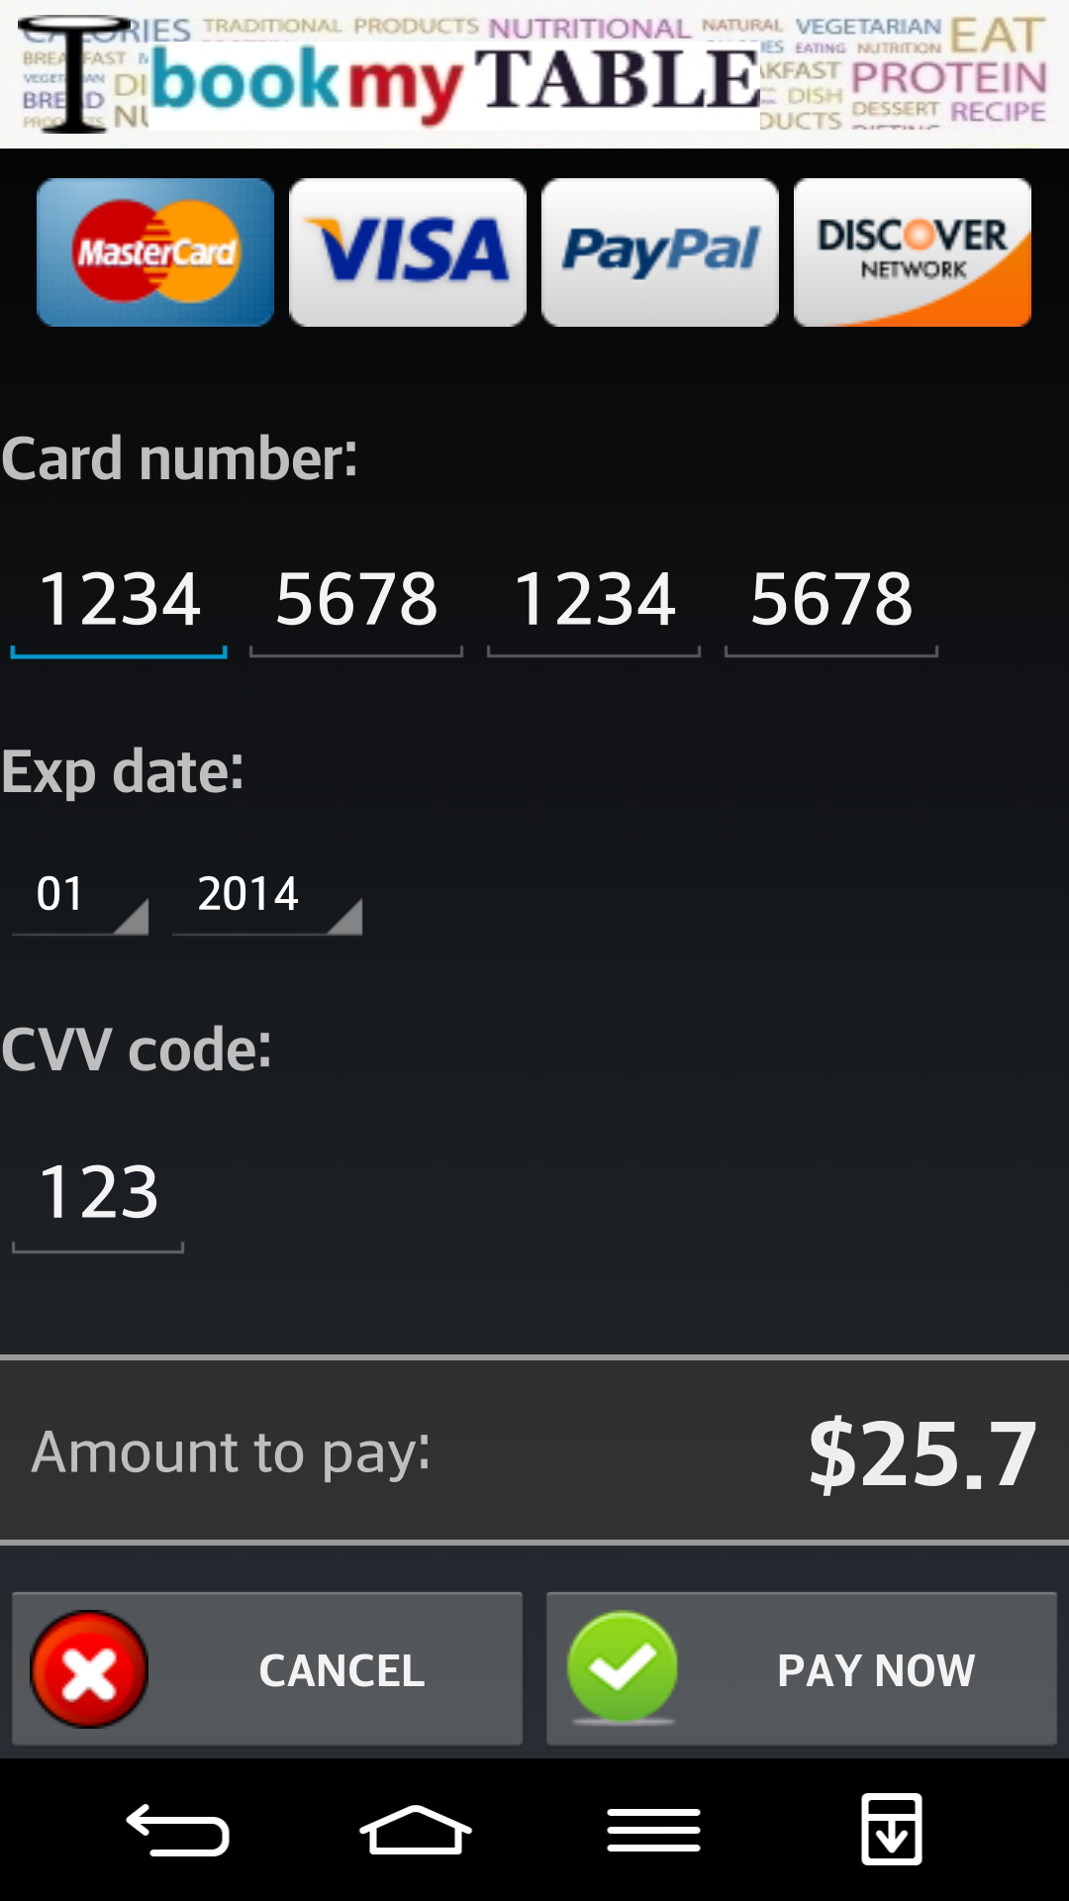

Slide 33
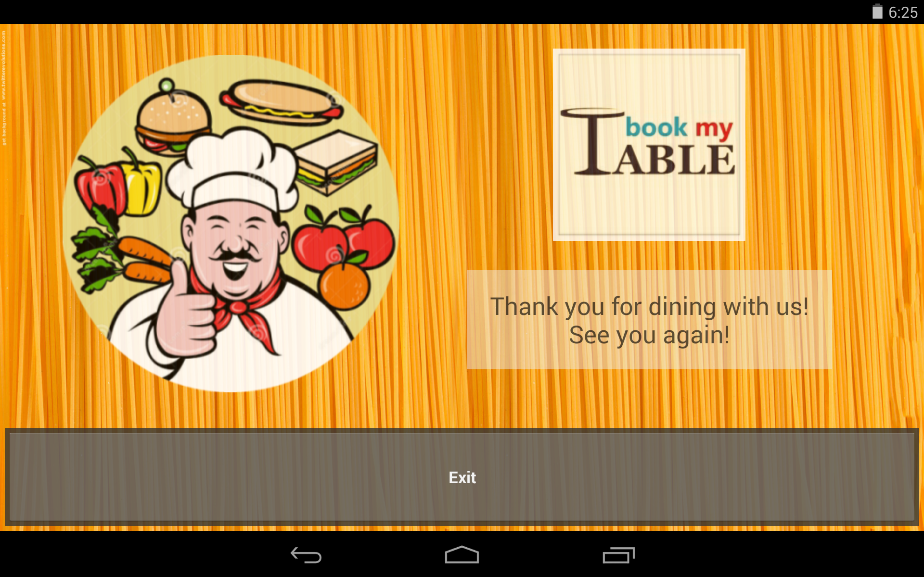

Slide 34

Will we show the Demo now?
YES! Of Course…

Slide 35

What design principles did we follow?
10 heuristics for User Interface design: J. Nielsen
Fitts’ Law

Slide 36
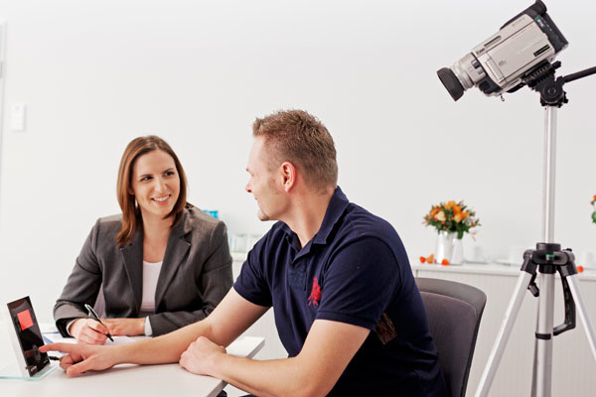
What changes we made?
Usability Testing

Slide 37
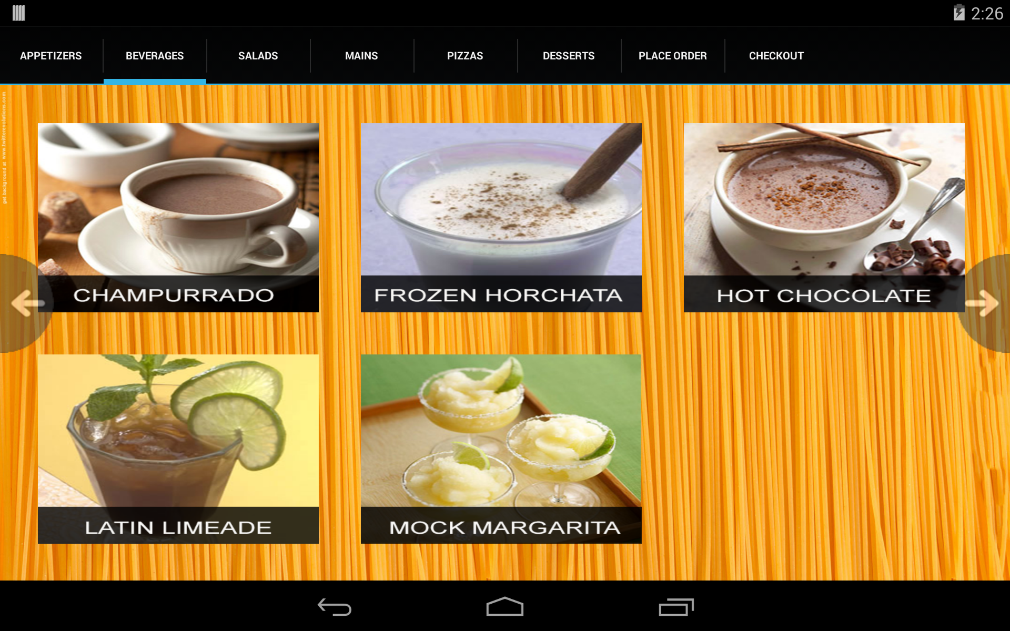
What changes we made?

Slide 38
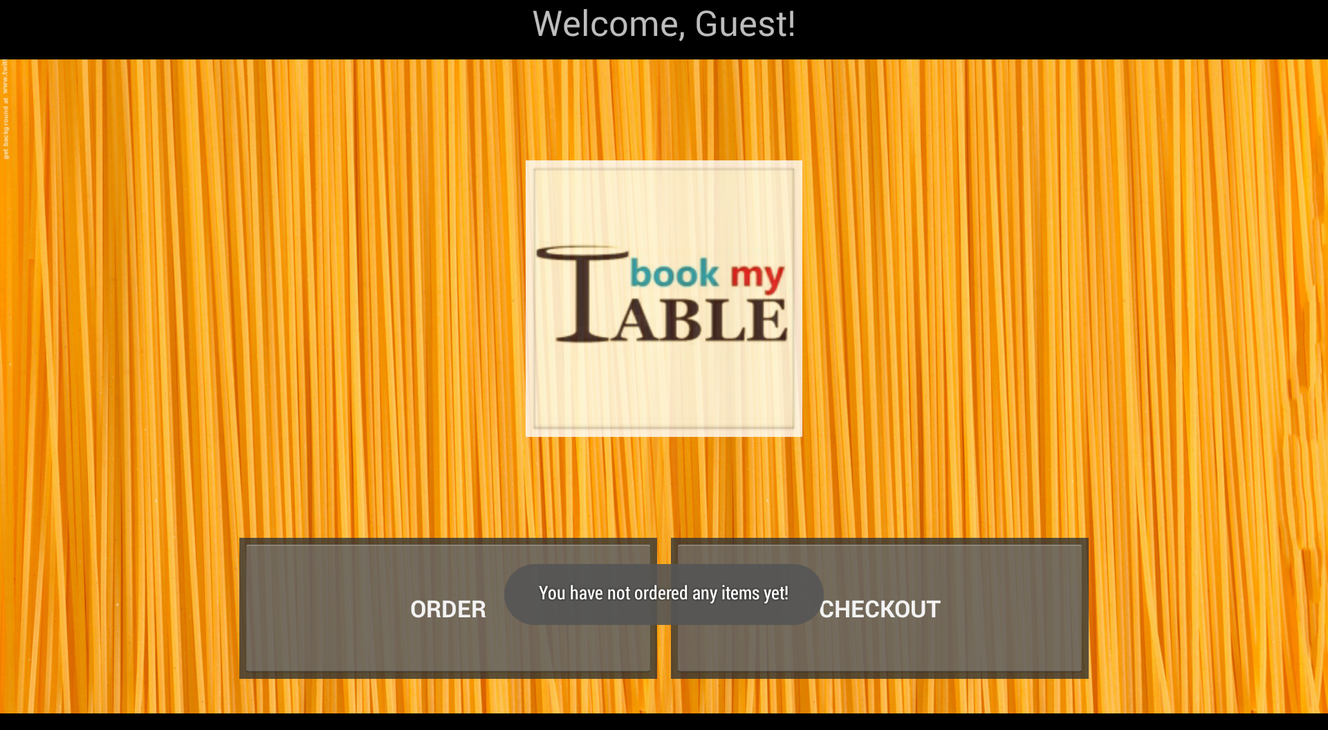
What changes we made?
Usability Testing

Slide 39
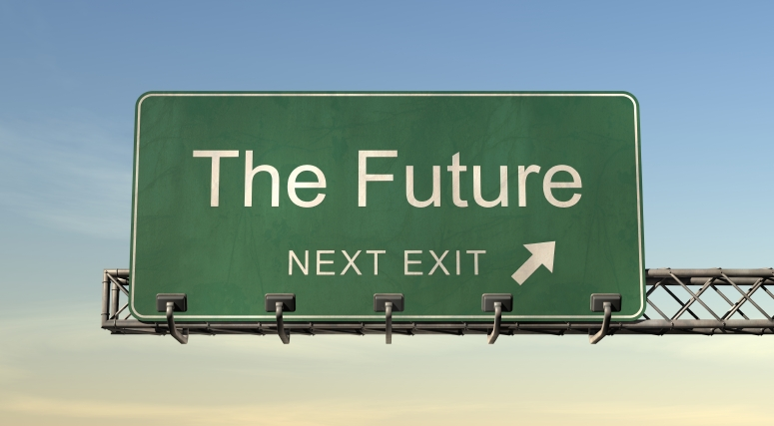
What is the future scope?

Slide 40
THANK YOU! ☺

